Slide 1

Deploying a Python Web App onto a Kubernetes Cluster
Tarun Pothulapati
@Pothulapati
Notes:
Introduction.

Slide 2
Agenda
Basic Python Web Application written in Flask
Deployment of a Web Application
Problems with Virtual Machines
Benefits of Containerisation
Docker Demo
Kubernetes Features and Architecture
Deploying Containers into Kubernetes and Scaling
Notes:
Explain the agenda
Not much python Code in this talk.
Ask Questions

Slide 3
Demo Python Web Application

Slide 4
Deployment
It is the process of taking your application and its dependencies into a server where an environment is configured. So, that the application can run without any problems.
Running a Single Application on a Single Standalone Server, would be a huge burden for maintenance and provisioning.
Virtualisation allowed us to run multiple applications each on it’s own Virtual Server on a Single Standalone Server.

Slide 5
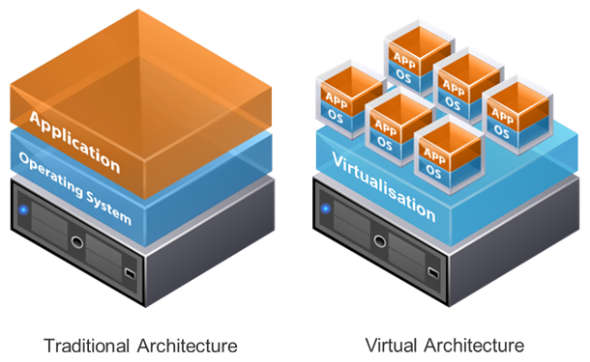
Virtual Machines

Slide 6
Problems with Virtual Machines
High Storage and Memory footprint as each VM has its own OS and Kernel.
Portability of Virtual Machine between public clouds, on premises or traditional data centres.
Adds weight to the overall Development Lifecycle for larger applications.
Slow Start Up Time, which isn't tolerable for highly scalable services.

Slide 7
Better Solution?
What if there was a way to package applications into a black boxes that don't have the Kernel and OS overhead.
These packages can be taken anywhere and would run the same?
These packages could be light weight but would provide Network, Memory, CPU isolation that is trustable?

Slide 8
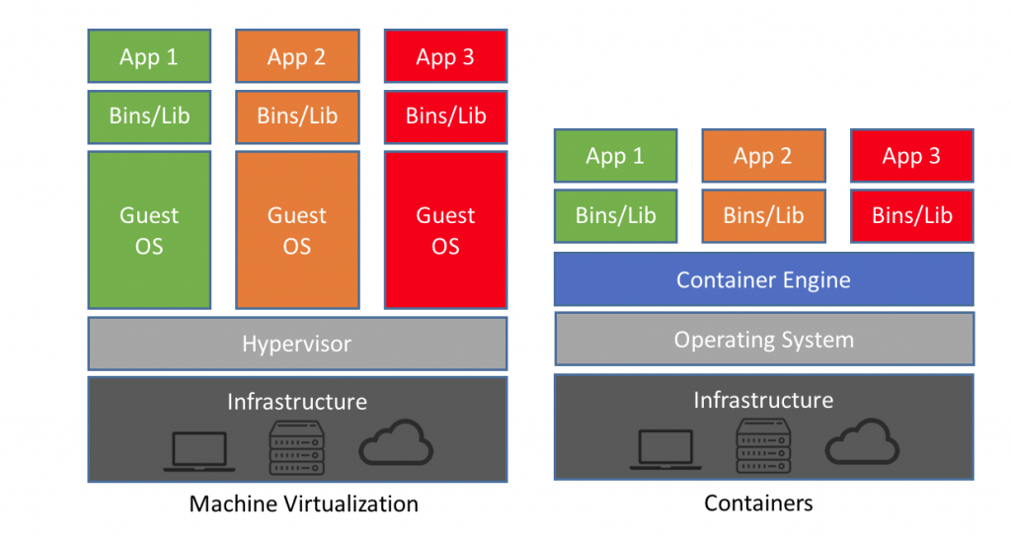
Containers

Slide 9
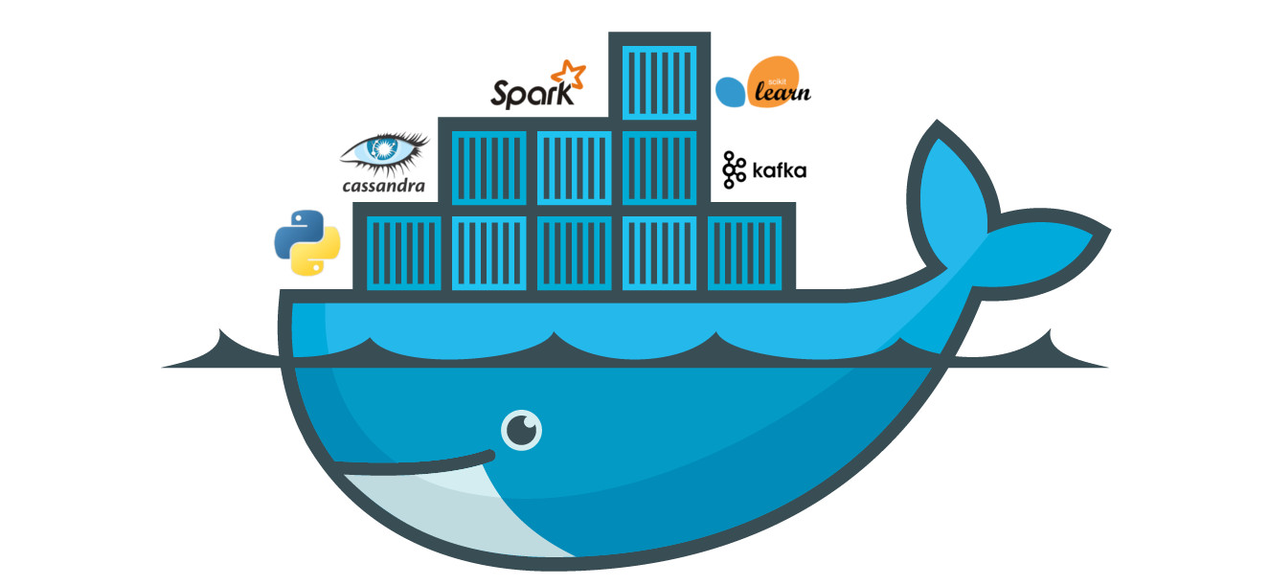
Docker

Slide 10
Benefits of Containers
Build, Ship, and Run Any App, Anywhere.
Low memory and storage footprint.
Container Images can be integrated with your CI/CD Pipeline.
Images can be versioned, Just like GIT repositiries.
Backup and rollback are very easy.

Slide 11
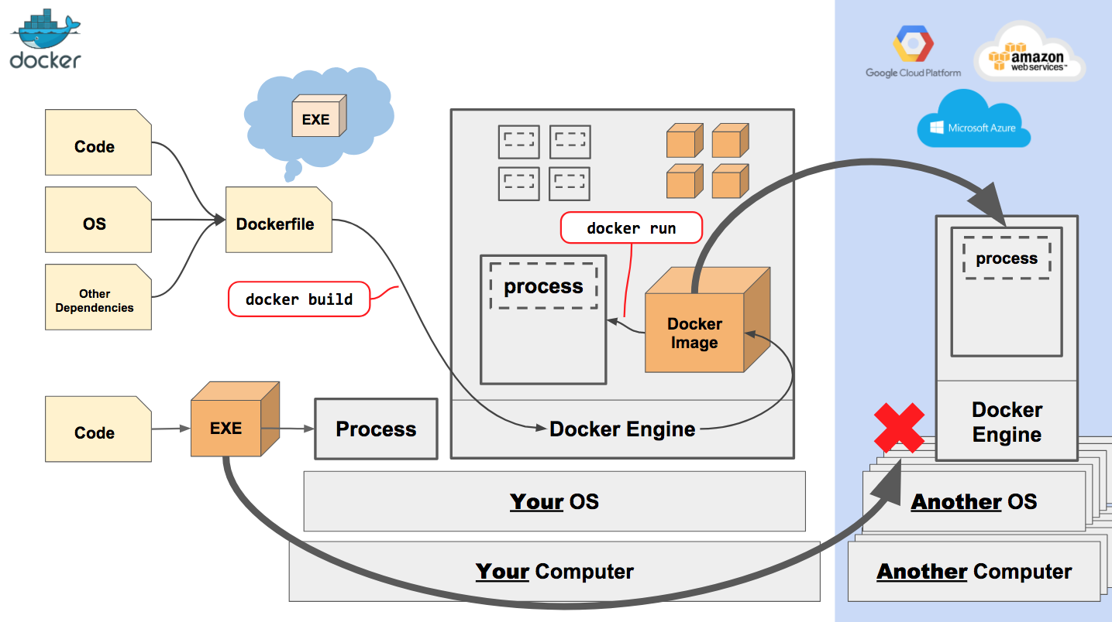
Docker Architecture

Slide 12
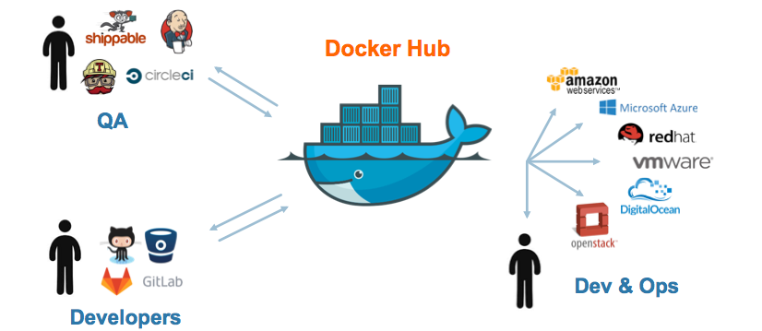
Container Registries

Slide 13
Demo Containerising the Python Web Application using Docker

Slide 14
Distributed Systems
Companies like Google, Facebook handle millions of requests every second.
Many thousands of servers are connected together to handle requests of that scale.
Distributed Systems allow us to run multiple servers in co-ordination to make it look like one single system where you can deploy multiple instances of your services.
The Distributed System will take care of failing over your services, when one of the servers go down.

Slide 15
Kubernetes An Open Source Production-Grade Container Orchestration System

Slide 16
Kubernetes Features
Self-Monitoring: Monitors the nodes and services without any manual intervention.
Automatic Scaling: Automatically scale the services both Horizontally and vertically based on resource usage or custom metrics.
Load Balancing: It understands the best servers to place your services. So, that all applications be on the best node possible.
Resource monitoring and logging: Insights on the resource usage and provides analytics on them.
Automates various other manual processes...

Slide 17
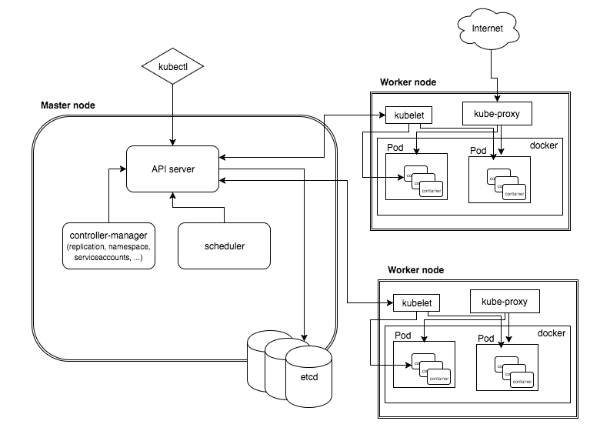
Kubernetes Architecture

Slide 18
Kubernetes API Server
Point of Communication with the Kubernetes Cluster.
Runs on the Master.
Exposes the Kubernetes API, which is the main point for managing the Kubernetes Cluster.
Everything is an object in Kubernetes i.e. Pods, Jobs, etc.
Communicates with the etcd store to create and delete objects.
Tools like kubectl,etc connect to the API server to perform actions and retrieve information.

Slide 19
Kubernetes Scheduler
Runs on the Master and takes decisions on the best node for the given workload to be placed.
Keeps track of the resource consumption on the cluster, and the total capacity of the cluster.
Also reshuffles the Workload throughout the cluster, when more nodes are being added.
Customisations are also allowed. Ex: Run ML workloads on nodes that have GPU's only.

Slide 20
Kubelet
"Node-Agent" that runs on every Node.
Kubelet ensures that the containers ordered are running and healthy.
Interacts with the container runtimes like docker to create, manage and delete containers.
Collects metrics about resource consumption and capacity by interacting with cAdvisor and reports to master.

Slide 21
Demo Running the python web app on a Kubernetes Cluster

Slide 22
Horizontal Pod Autoscaler
Kubernetes can automatically increase the number of pods running to handle the scale without any user intervention.
Horizontal Pod Autoscaler (HPA) allows you to scale your pods horizontally i.e create more replica’s of it based on some metrics.
The Metrics can be CPU, Memory, Number of Requests, etc. Custom Metrics are also allowed.

Slide 23
Demo HPA in Action

Slide 24
Glimpse into the Future...
More and More abstractions being built on top of Kubernetes like Custom Controllers, Operators, CRD's, etc.
Tools like helm are being built to make managing deployment of stateful applications like MySQL, etc easy.
Hard Multitenancy on a cluster is also being worked on.

Slide 25
Thank You! :D Feel free to ask any Questions or Talk to me about Distributed Systems, Opportunities.
You can also reach me out on twitter at @pothulapati

